Slide 1
Software Testing
Kyle Bentley, Joseph Perry, Aeon Toran
SDC 360: Web Application
July 22, 2025

Slide 2
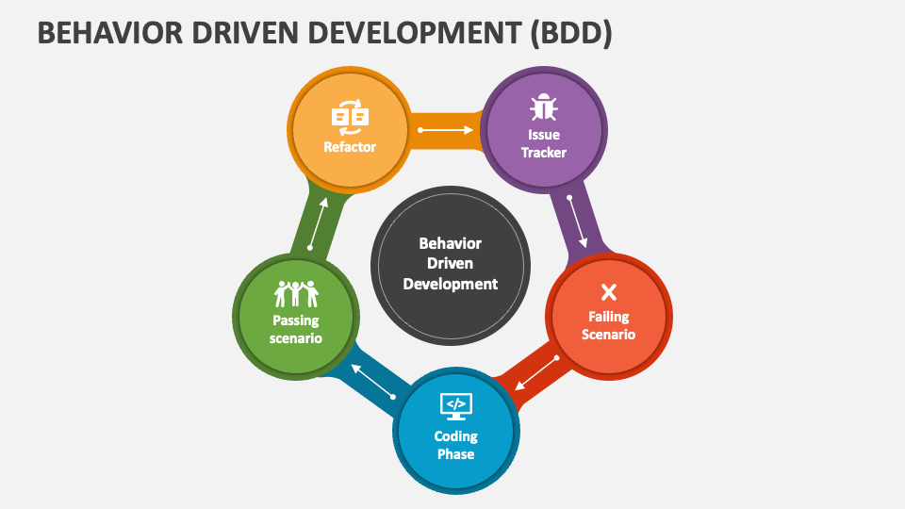
Behavior Driven Development
Focuses on a software's behavior
Starting point is a scenario
Describe desired behavior -> Define Requirements -> Develop & Test -> Refactor -> Pass the tests and implement
Pros:
Enhanced communication
User experience focus
Clear project requirements
Continuous Feedback
Cons:
Multiteam involvement
Time-consuming
Tool dependent
Possible overhead
Notes:
Enhanced Communication: talk to clients throughout the development process to ensure goals are met
User Experience: Designed from the perspective of a client/user
Clear project requirements: Clients are involved from start to finish
Multiteam: larger teams may struggle to coordinate all the parts
Time consuming: spending time defining behaviours/communicating with client can slow down development
Tool dependent: dependencies and other copmplexities may require specific tools to avoid disrupting development
Overhead: additional teams/project requirements may make development more costly

Slide 3
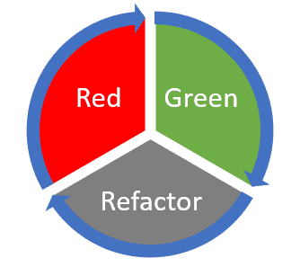
Test Driven Development Test Driven Development (TDD) is a methodology that emphasizes writing tests before writing the actual code. This approach ensures that the code meets predefined requirements and functions as expected before development progresses further.(Testlio, 2024)
Pros
TDD offers Robustness where the developers can write test covering the function before the implementation
It has fewer bugs since it has already been tested and checked
During the test, the developer augments the code usually creating a better and more cohesive design
Lastly during the test everything is documented for clarity. This in turn tells any other developer what each function of the code is supposed to do
Cons
It takes a lot more planning to write the test code and test it out
The learning curve is steeper since the developers have to be used to starting from scratch and creating an entire architecture of code and make it work.
There is a possibility of over writing code making it too complex for what is needed. In the process of trying to make everything cohesive the code could become more redundant than necessary

Slide 4
Examples irl
TDD
In 2003 IBM Retail Store Solutions built a non-trivial software system using rigorous unit testing and a build approach based on TDD.
BDD
"BDD is at the heart of our development practices. Not only are our developers involved but also testers, business analysts, etc. It is also a key element in our agile transformation process and is what made it possible for us to truly do continuous delivery." - Gilles Philippart of Société Générale Corporate Investment Banking (SGCIB)
PayPal Software Engineers also attribute a large part of their success in finding and fixing bugs to BDD

Slide 5
References
Maximilien, E. M., & Williams, L. (2003). Assessing test-driven development at IBM. In Proceedings of the 25th International Conference on Software Engineering (ICSE '03) (pp. 564–569). Association for Computing Machinery. https://doi.org/10.5555/776816.776892
Hellesøy, A. (2015, July 1). BDD in the financial sector. Cucumber. https://cucumber.io/blog/bdd/bdd-in-the-financial-sector/
GeeksforGeeks. (2024, July 12). Difference between BDD vs TDD in software engineering. https://www.geeksforgeeks.org/software-engineering/difference-between-bdd-vs-tdd-in-software-engineering/
What is behavior-driven development (BDD)?. GeeksforGeeks. (2024, June 17). https://www.geeksforgeeks.org/software-engineering/behavioral-driven-development-bdd-in-software-engineering/
Kostic, N. (2024, May 7). TDD vs. BDD: Detailed overview and comparison. phoenixNAP Blog. https://phoenixnap.com/blog/tdd-vs-bdd
Testlio. (2024, September 27). TDD and BDD – Differences and similarities explained. Testlio. Retrieved July 22, 2025, from https://testlio.com/blog/tdd-vs-bdd/

